Slide 1
Enhancing the Cell Ontology at UTSW: the Hematopoietic Cell Knowledgebase
Dave Dougall, PhD
Laboratory of Dr. Richard Scheuermann
UTSW Medical Center

Slide 2
Ontology vs. Knowledgebase
Ontology – necessary and sufficient information required to define a cell type
Very often minimal information in a cell type definition
Surface markers, Cytokines, Transcription Factors, etc.
Knowledgebase – all information about a given cell type

Slide 3
Expanded Information in CL
Hematopoietic Cells
Updated phenotype, synonyms, GO terms, and new subtypes
Phenotype for flow cytometry, RT-PCR, Western, etc.
List of signaling molecules for ELISA and biological network analysis
Synonyms for Natural Language Processing (NLP)
ImmuneXpresso (Shai Shen-Orr & Mark Davis)
Sanda Harabagiu (SMU)
ImmPort (Resources Tab/Cell Type Ontology)

Slide 4
Previous Mast Cell Entry (CL)
id: CL:0000097
name: mast cell
def: "A cell that is found in almost all tissues containing numerous basophilic granules and capable of releasing large amounts of histamine and heparin upon activation. A marker for this cell is being kit-high." [GOC:add, GOC:tfm, ISBN:068340007X, MESH:A.11.329.427]
synonym: "Histaminocyte" EXACT []
synonym: "labrocyte" EXACT [ISBN:0721601464]
synonym: "mastocyte" EXACT [ISBN:0721601464]
synonym: "tissue basophil" RELATED [ISBN:068340007X]
xref: FMA:66784
is_a: CL:0000766 ! myeloid leukocyte
is_a: CL:0002274 ! histamine secreting cell
intersection_of: CL:0000766 ! myeloid leukocyte
intersection_of: capable_of GO:0002349 ! histamine production involved in inflammatory response
intersection_of: capable_of GO:0030210 ! heparin biosynthetic process
intersection_of: has_high_plasma_membrane_amount PRO:000002065 ! mast/stem cell growth factor receptor
intersection_of: has_part GO:0030141 ! stored secretory granule
relationship: develops_from CL:0000831 ! mast cell progenitor

Slide 5
Mast Cells Updated
id: CL:0000097
name: mast cell
def: "A cell that is found in almost all tissues containing numerous basophilic granules and capable of releasing large amounts of histamine and heparin upon activation. Progenitors leave bone marrow and mature in connective and mucosal tissue. Mature mast cells are found in all tissues, except the bloodstream. Their phenotype is CD117-high, CD123-negative, CD193-positive, CD200R3-positive, and FceRI-high. Stem-cell factor (KIT-ligand; SCF) is the main controlling signal of their survival and development." [GOC:add, GOC:dsd, GOC:tfm, ISBN:068340007X, MESH:A.11.329.427, PMID:15153310, PMID:16330751, PMID:16455980, PMID:18483499, PMID:19671378, PMID:9354811 MESH:D008407]
comment: Mast cells are generally integrin beta-7-negative and positive for TLR2, TLR3, TLR4, TLR5, TLR7, TLR9, C3aR, C5aR, CR3, CR4, VEGF, FGF2, and renin. They can express MHC Class I and II on their surface. Activated murine mast cells (IgE+Antigen) were capable of expressing the following co-stimulatory molecules: CD95 (Fas), CD120b, CD137 (4-1BB), CD153 (CD30L), CD154 (CD40L), GITR, ICOSL, OX40L, PD-L1, and PD-L2. Note that there was some mouse strain variation. Mast cells have also been demonstrated to produce bFGF, CCL2, CCL4, CCL5, CCL11, CCL20, CXCL2, CXCL10, GM-CSF, IFN-gamma, IL-1, IL-2, IL-3, IL-8, IL-10, IL-11, IL-12, IL-13, IL-16, IL-25, IL-18, MIP-1, prostaglandin D2, SCF, TGF-beta, TNF-alpha, TSLP, VEGF, and XCL1. They express the transcription factors GATA-1 and MITF.
intersection_of : capable_of GO:0002539 ! prostaglandin production involved in inflammatory response
intersection_of : capable_of GO:0002660 ! positive regulation of peripheral tolerance induction
intersection_of : capable_of GO:0002690 ! positive regulation of leukocyte chemotaxis
intersection_of : capable_of GO:0002830 ! positive regulation of type 2 immune response
intersection_of : has_high_plasma_membrane_amount PRO:000007431 ! high affinity immunoglobulin epsilon receptor subunit alpha
intersection_of : has_plasma_membrane_part PRO:000001255 ! chemokine receptor CCR3
intersection_of : lacks_plasma_membrane_part PRO:000001865 ! interleukin-3 receptor class 2 alpha chain
Notes:
Only new information shown in the interest of space.

Slide 6
Previous Entries for Mast Cell Subsets
id: CL:0000484
name: connective tissue type mast cell
def: "A mast cell of the connective tissue." [GOC:add, GOC:tfm, PMID:19923473]
is_a: CL:0000097 ! mast cell
intersection_of: CL:0000097 ! mast cell
intersection_of: part_of UBERON:0002384 ! connective tissue
id: CL:0000485
name: mucosal type mast cell
def: "A mast cell of a mucosal tissue." [GOC:add, PMID:19923473]
is_a: CL:0000097 ! mast cell
intersection_of: CL:0000097 ! mast cell
intersection_of: part_of UBERON:0001961 ! mucosa-associated lymphoid tissue

Slide 7
Mucosal Mast Cells (Updated)
id: CL:0000485
name: mucosal type mast cell
def: "Mast cell subtype that contains only the serine protease trypase in its granules. These cells are primarily found in mucosal tissue, such as intestinal mucosa and alveoli. They depend upon T-cells for development of phenotype." [GOC:add, GOC:dsd, PMID:19923473, PMID:9354811]
comment: They are CD88-negative. The cytoplasmic granules contain low levels of histamine and high levels of chondroitin sulfate (mouse) or major neutral proteases and tryptase (humans). Additionally, they can produce leukotrienes (LTC4), IL-5, IL-6, and low levels of IL-4. They are reportedly very heterogeneous depending upon location and can convert to the MC(T) phenotype.
synonym: "MC(T)" EXACT []
synonym: "MCT" EXACT []
is_a: CL:0000097 ! mast cell
intersection_of: CL:0000097 ! mast cell
intersection_of: capable_of GO:0002540 ! leukotriene production involved in inflammatory response
intersection_of: part_of UBERON:0001961 ! mucosa-associated lymphoid tissue

Slide 8
Problems/Issues Encountered
What to consider as positive & negative?
Based on percentage of cells?
Threshold?
Levels of Positive (low, intermediate, high)?
Methodology (different sensitivity)
Include inferred Expression?
IgM-, IgD-, …. (everything but B-cells)
Species
Human vs. Mouse Markers
Tissue Source
BM, PBMC, Spleen, LN, Thymus, etc.

Slide 9
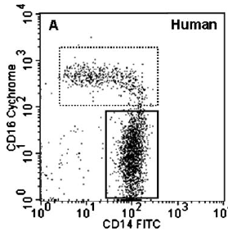
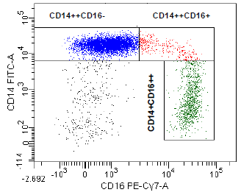
Flow Cytometry
Labeling as positive or negative
List cell type as % positive?
Should there be a % threshold for labeling a cell type as being “positive”?
CD14 FITC
CD16 Cychrome
Mobley (2007) Inflammation 30: 189-197
Zawada et al. (2011) Blood 118(12): e50-e61
Notes:
Figures from (left) Mobley (2007) Inflammation 30: 189-197 (right) Zawada et al. (2011) Blood 118(12): e50-e61. Both from human

Slide 10
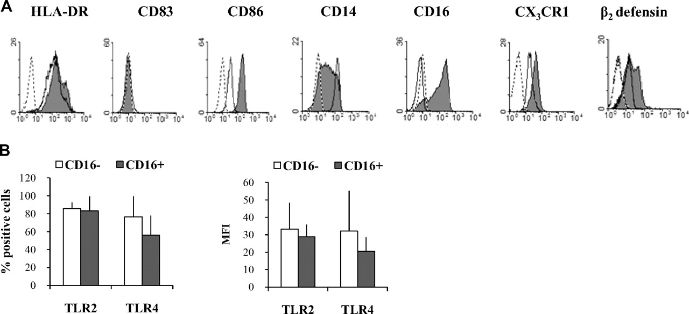

Phenotype of human Mo. (A) Phenotype of freshly purified human CD16– (empty histograms) and CD16+ (filled histograms) Mo in a representative donor, assessed by flow cytometry.
CD16-Monocytes
CD16+ Monocytes
What is considered “positive” for a population?
Are there two separate populations?
Aguilar-Ruiz S R et al. J Leukoc Biol 2011;90:1119-1131
©2011 by Society for Leukocyte Biology
Notes:
Phenotype of human Mo. (A) Phenotype of freshly purified human CD16– (empty histograms) and CD16+ (filled histograms) Mo in a representative donor, assessed by flow cytometry. Dotted histograms correspond to isotype control antibodies. (B) Percentage of positive cells (left panel) and the MFI (right panel) of TLR2 and TLR4 in CD16– (open bars) and CD16+ (solid bars) Mo. Data are representative of six different donors.

Slide 11
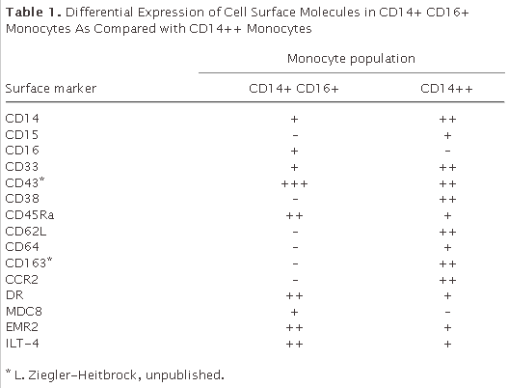
Flow Cytometry
How many levels of expression?

Slide 12
Table 1. Differential Expression of Cell Surface Molecules in CD14+ CD16+ Monocytes As Compared with CD14++ Monocytes
Surface marker | Monocyte population
 | CD14+ CD16+ | CD14++
CD14 | + | ++
CD15 | – | +
CD16 | + | –
CD33 | + | ++
CD43* | +++ | ++
CD38 | – | ++
CD45Ra | ++ | +
CD62L | – | ++
CD64 | – | +
CD163 | – | ++
CCR2 | – | ++
DR | ++ | +
MDC8 | + | –
EMR2 | ++ | +
ILT-4 | ++ | +
+ = low or positive?
++ = intermediate or positive?
+++ = positive or high?
Ziegler-Heitbrock (2007) J. Leukocyte Biology 81: 584-592.
Notes:
Ziegler-Heitbrock (2007) J. Leukocyte Biology 81:584-592.

Slide 13
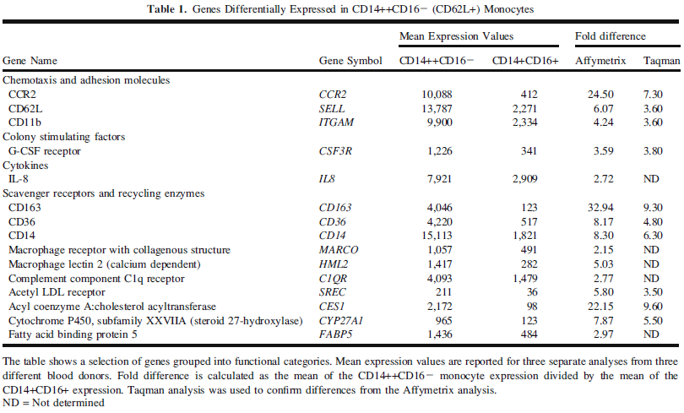
Microarray Results
What is “positive”?
Mobley et al. (2007) Inflammation 30:189-197
Notes:
Mobley et al. (2007) Inflammation 30:189-197

Slide 14
Species Specific
Hematopoietic Stem Cells
Human: CD133+
Mouse: c-kit+ Sca-1+
Tregs & FoxP3 expression
Mouse = Yes definition
Human = No definition

Slide 15
Started to Include
References (PubMed)
Experimental Method
Flow cytometry
Microarray
RT-PCR
ELISA (cytokine production)
Should I Include?
Species
Focus on Humans

